Slide 1
80286 Memory management and Protected mode addressing
The Intel Microprocessors 8th Edition by Barry B Brey
2-2 Real mode memory addressing page 58
2-3 Introduction to protected mode memory addressing page 63
2-4 Memory paging page 68
Advanced microprocessors and peripherals Chapter 9
Md. Shafqat Talukder Rakin
Lecturer, Department of CSE,
United International University
Email id : shafqat@cse.uiu.ac.bd
Courtesy: Nasif M. Sir

Slide 2
Contents
Limitation of Real mode operation
Importance of Memory Management Unit (80286)
Virtual memory
Advantage of Virtual memory
Protected Mode Operation 80286
  Selector
  Descriptor table
  Access Rights Byte
  Privilege Levels

Slide 3
A. Limitation of Real mode operation
The 8086 and 8088 Micro-processors operate only in Real mode. The limitation of real mode are:
The Micro-processor can access only 1 MB of memory. This memory is referred to as real mode memory.
Real mode operation allows only a single program to run at a time under a uni-tasking operating system such as DOS.

Slide 4
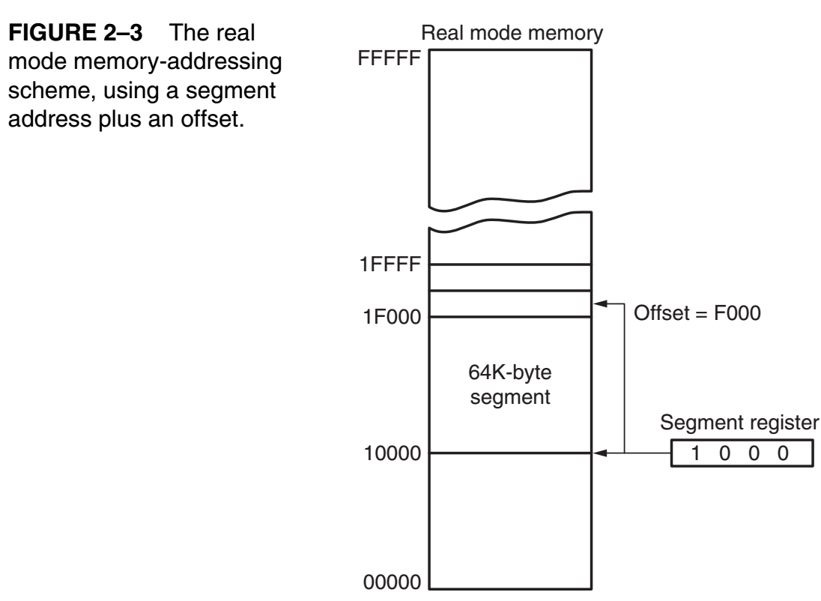

Slide 5
B. Importance of Memory Management Unit
In advanced microprocessor, memory management becomes extremely important. Memory management is required due to the following two reasons.
Limitation of physical memory - Manage virtual memory
Need for Protection

Slide 6
1. Limitation of physical memory
A microprocessor has limited number of address lines. Hence the physical memory addressability is limited. Increasing the number of address lines is not attractive as it makes the architecture and design complex without significant gain. Packaging becomes difficult and expensive. Memory Management Unit (MMU) solves this problem by translating the virtual memory address into the physical memory address. Virtual memory can be many times larger than the physical memory. Only the programs currently required are brought from the secondary storage such as a hard disk to the physical memory (RAM) for execution.

Slide 7
2. Need for Protection
Another important aspect of memory management is 'data protection' or unauthorized access prevention. This concept came with the concept of 'segmented memory'. For example, the data lies in data segment, executable code lies in the code segment and stack information lies in the stack segment. In case the stack data overlaps the executable code or the code segment overlaps the stack data, the complete program execution will lead to random results. Thus, separation of these data types into different logical segments is necessary for data protection.

Slide 8
C. Virtual memory managed by MMU
Let us consider that one or more application program have to be executed by the microprocessor. At any instant, a segment portion of the program, required for execution at that instant, exists in the physical memory at the time of execution. These segments portions of the program which have been already executed or are not required for execution at that instant, are available in the secondary memory. Whenever, the portion of a program is required by the microprocessor, it is fetched from the secondary memory and placed in the physical memory. This is called 'swapping in' of the program. A portion of the program required for further execution, may be saved back on secondary storage to make the physical memory free for further execution of another required portion of the program. This is called 'swaping out' of the executable program. Thus, from a programmer’s view point, there exists a large memory space which is not actually present in the system memory. As the name suggests, virtual memory does not exist physically in a system. However, it is possible to map a large virtual memory space on to the real physical memory.

Slide 9
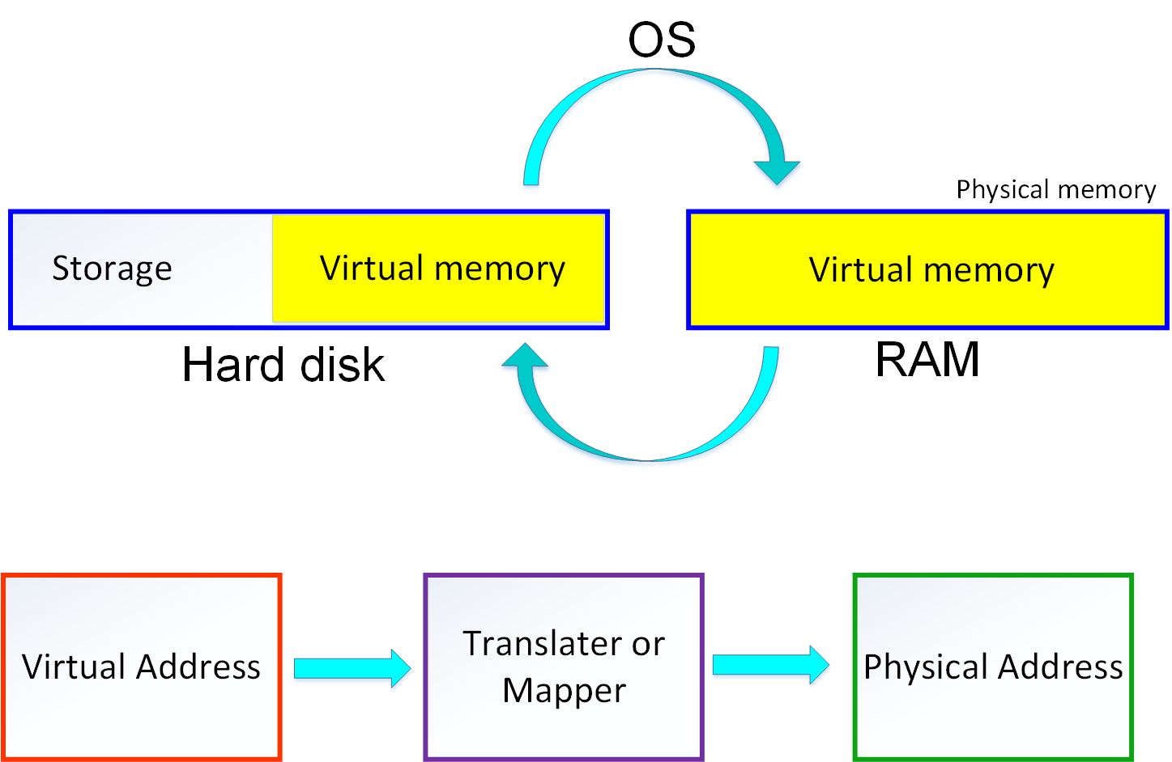
C. Virtual memory managed by MMU

Slide 10
D. Advantage of Virtual memory
Solve limited physical memory size
Solve discontinuous memory address problem
Provide program protection

Slide 11
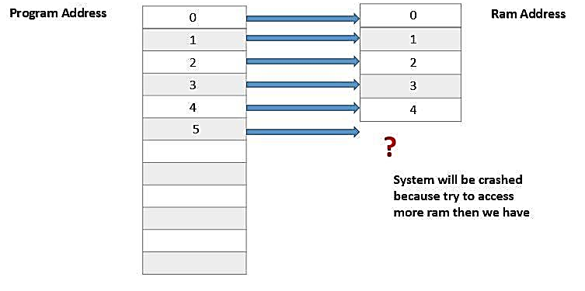
D. Advantage of Virtual memory
Solve limited physical memory size
Without the virtual memory program address directly map to the RAM addresses that means there is one to one relation exist between the program and RAM memory addresses.

Slide 12
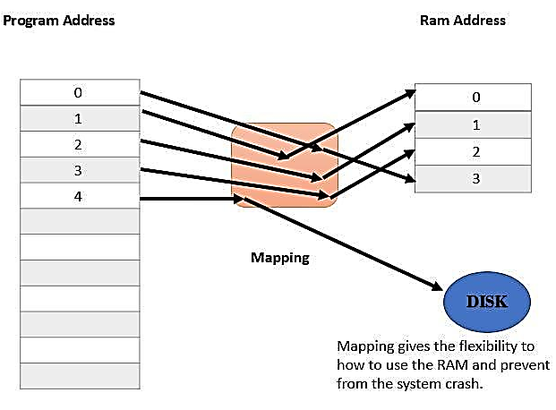
D. Advantage of Virtual memory
Solve limited physical memory size
We can solve this problem by using the virtual memory, it creates a layer (managed by the MMU) between the RAM and program address which is used to map the program address and RAM address and prevent the system being crash.

Slide 13
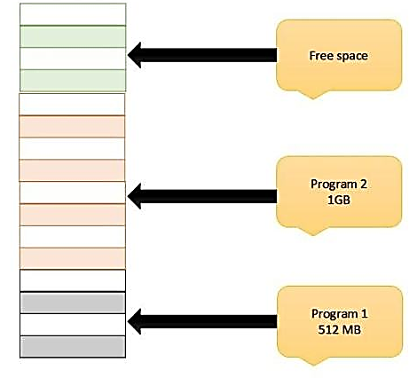
D. Advantage of Virtual memory
2. Solve discontinuous memory address problem
Suppose there is two programs running simultaneously. The first program required 512 MB and second program required 1 GB of physical memory for the execution.
512 MB
1 GB
512 MB

Slide 14
D. Advantage of Virtual memory
2. Solve discontinuous memory address problem
When the first program is terminated by the user then memory which occupied by the first program will be released and now we have the total 1GB amount of free space to execute the other program, but there is one drawback, free memory is not continuous.
So if the user runs a third program which has required only 1 GB of physical memory still unable to execute because it wants a continuous 1GB free memory even though we have 1 GB of memory space that’s the cause of memory fragmentation.

Slide 15
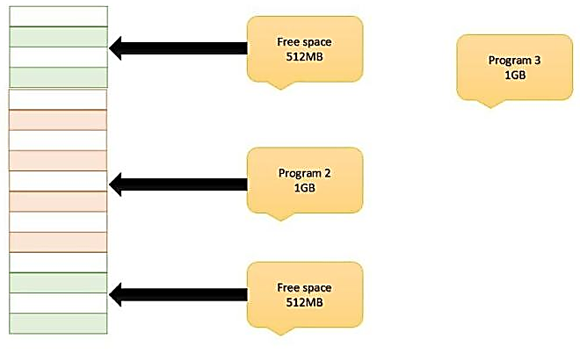
D. Advantage of Virtual memory
2. Solve discontinuous memory address problem

Slide 16
D. Advantage of Virtual memory
2. Solve discontinuous memory address problem
We can solve this problem using the virtual memory because, with virtual memory, we do not directly access the physical memory. MMU play a vital role and map the program address space to the physical address space. Each program has own mapping and using the mapping we can put our program data any location in the RAM.

Slide 17
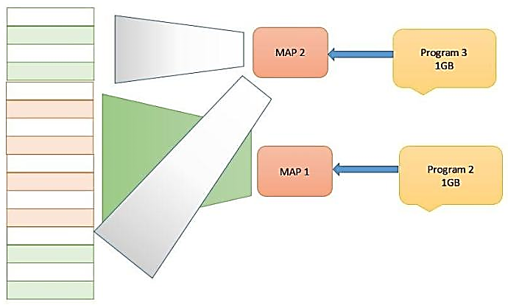
D. Advantage of Virtual memory

Slide 18
C. Advantage of Virtual memory
3. Provide program protection
In a multitasking system, each program can access memory address. So the problem occurs when two programs share the same address of address space to store their result.
In that situation result of one program can be altered by another program and we will not get our desired result. It can be solved by the virtual memory.

Slide 19
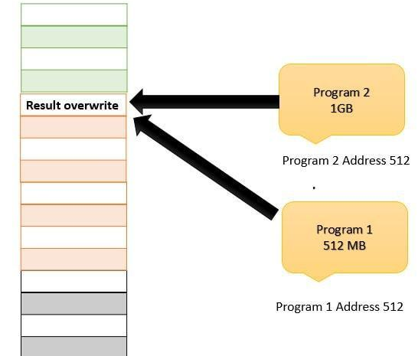
D. Advantage of Virtual memory
3. Provide program protection

Slide 20
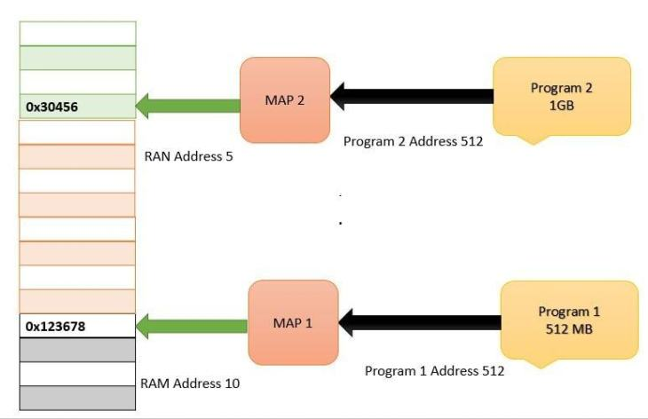
D. Advantage of Virtual memory
3. Provide program protection
Here program 1 and 2 have their own program address space so they can not access each other data and their program address space map (managed by MMU) with different RAM address.

Slide 21
E. Protected Mode Operation (1)
The 80286 and above Micro-processor’s can operate in Real mode and Protected mode. The features of Protected mode are:
In Protected mode, the Micro-processor can access memory above 1 MB.
Protected mode supports Virtual memory which is a memory management technique that extends Micro-processor’s capability to access memory beyond it’s maximum possible physical memory.
Protected mode allows multitasking. Multitasking refers to loading multiple programs into memory and executing them simultaneously under a multitasking operating system such as Windows.

Slide 22
E. Protected Mode Operation (2)
Most programs written to function in the real mode will function without change in the protected mode.
The difference between Real mode and Protected mode is the way, that the segment register is interpreted by the Microprocessor to access the Memory segment.
Segments size can be variable. Segments may begin at any address of the Micro-processor’s physical memory.
Indirectly, the segment register still selects a memory segment, but not directly as in the real mode. For example, in the real mode, if , the code segment begins at location 00080H. In the protected mode, this segment number can address any memory location in the entire system for the code segment, as explained shortly.

Slide 23
E. Protected Mode Operation (80286)
In place of the Segment address, the Segment register contains a Selector.
The Selector selects a Descriptor from a Descriptor table.
The Descriptor describes the Memory segment's location, length, and access rights.

Slide 24
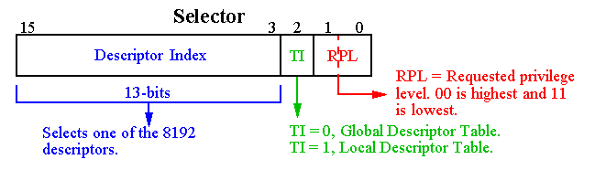
Figure: The contents of a segment register during Protected mode operation of the 80286 microprocessors
E. Protected Mode Operation (80286)
Segment
Register,
e.g. DS, CS
Segment selector
(2¹³ = 8192)
16 bits Segment register = 13 bit descriptor Index + 1 bit descriptor table selector + 2-bit requested privilege

Slide 25
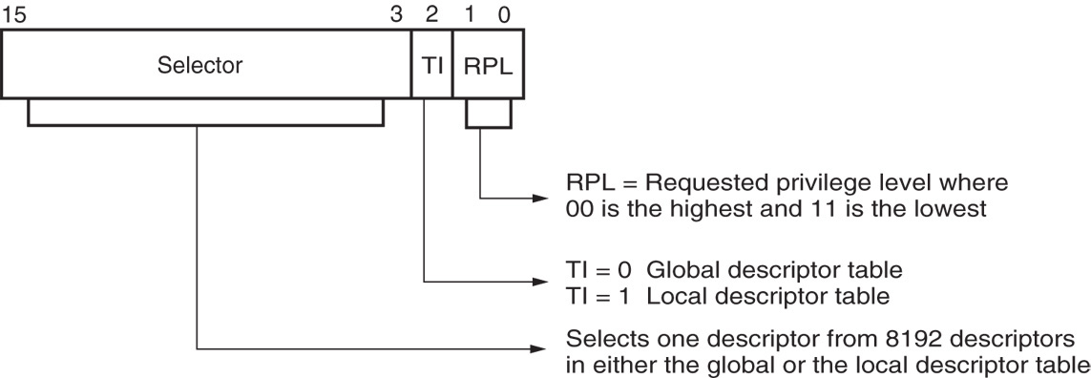
Figure 2–8 The contents of a segment register during protected mode operation of the 80286 through Core2 microprocessors.

Slide 26
Exercise questions
29. If the DS register contains 0020H in a protected mode system, which global descriptor table entry is accessed?
30. If DS = 0103H in a protected mode system, the requested privilege level is _________.
31. If DS = 0105H in a protected mode system, which entry, table, and requested privilege level are selected?

Slide 27
Exercise questions
29. If the DS register contains 0020H in a protected mode system, which global descriptor table entry is accessed?
Ans: 0020H = 0000 0000 0010 0000 B
0000 0000 0010 0 = 4
30. If DS = 0103H in a protected mode system, the requested privilege level is _11________.
31. If DS = 0105H in a protected mode system, which entry, table, and requested privilege level are selected?
Ans: 0105H = 0000 0001 0000 0101 B
Privilege level = 01
Local Descriptor table because 1
Entry number = 0000 0001 0000 0 = 32

Slide 28
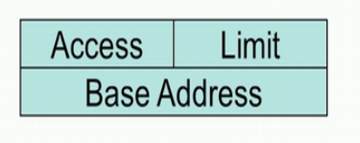
Descriptor table
Large programs are divided in either small segments or pages in appropriate sequence. They are swaped in or out of primary memory for the requirement of execution of the complete program. These segments or pages have been associated with a data structure called as a descriptor. The descriptor contains information of the program segment or page. A set of such descriptors arranged in a proper sequence describes the complete program. This set of descriptors are called the descriptor table and managed by the operating system.
Segment descriptor

Slide 29
Descriptor table
Segment descriptor
For accessing any program segment,
1. Corresponding descriptor is accessed and its access right contents are verified with segment selector
2. The base and limit fields of the descriptor contain information which is used for finding out physical address of the program segment.
3. The base address portion of the descriptor indicates the starting location of the memory segment. For the 80286 microprocessor, the base address is a 24-bit address, so segments begin at any location in its 16M bytes of memory.

Slide 30
Descriptor table
Segment descriptor
The 80386 and above use a 32-bit base address that allows segments to begin at any location in its 4G bytes of memory.
The segment limit contains the last offset address found in a segment. For example, if a segment begins at memory location F00000H and ends at location F000FFH, the base address is F00000H and the limit is FFH. For the 80286 microprocessor, the base address is F00000H and the limit is 00FFH. For the 80386 and above, the base address is 00F00000H and the limit is 000FFH.
Notice that the 80286 has a 16-bit limit and the 80386 through the Pentium 4 have a 20-bit limit. An 80286 can access memory segments that are between 1 and 64K bytes in length. The 80386 and above access memory segments that are between 1 and 1M byte, or 4K and 4G bytes in length.

Slide 31
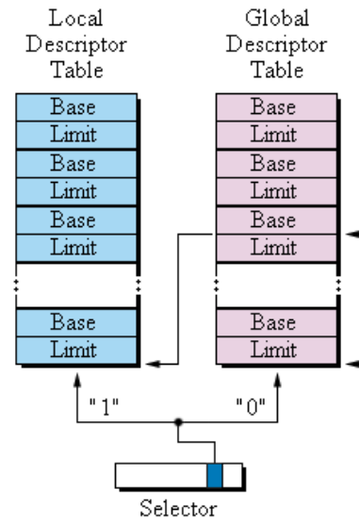
Descriptor table

Slide 32
Descriptor table
For example, a school teacher may stack all the answer sheets solved by the students in a bundle and attached a small slip of paper with it containing the information like name, subject, class, date, year, name, number of students. From this information, a third person can easily know the details of the particular bundle of papers.

Slide 33
Protected Mode Operation (80286)
Descriptor table
Two types of Descriptor table selected by the Segment register.
Global descriptor table contain segment definitions that apply to all programs. Each row of the Global descriptor table is called a global descriptor or system descriptor.
Local descriptor table contain segment definitions that apply to a single program. Each row of the Local descriptor table is called a local descriptor or application descriptor, which provides information that are unique to an application.

Slide 34
Protected Mode Operation (80286)
Descriptor table
Each descriptor is 8 bytes long (64 bit).
Global and Local Descriptor tables are maximum of 64K bytes in length.
The global descriptor table’s base address and limit is stored in GDTR.
The local descriptor table’s base address and limit is stored in LDTR.
Notes:
8192 number of descriptor require 8192 * 8 byte = 64 KB of memory.

Slide 35
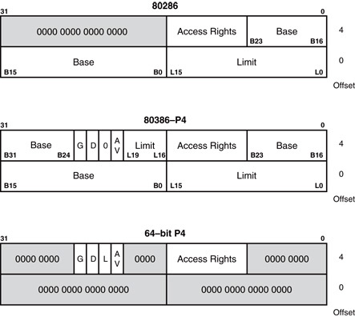
The format of a Descriptor table for the 80286

Slide 36
The base address of the descriptor indicates the starting location of the memory segment.
  the paragraph boundary limitation is removed in protected mode
  segments may begin at any address
The G, or granularity bit allows a segment length of 4K to 4G bytes in steps of 4K bytes.
  32-bit offset address allows segment lengths of 4G bytes
  16-bit offset address allows segment lengths of 64K bytes.

Slide 37
DESCRIPTORS:
Base (B31 – B0): indicates the starting location (base address) of the memory segment. This allows segments to begin at any location in the processor's 4G bytes of memory.
Limit (L19 – L0): contains the last offset address found in a segment. Since this field is 20 bits,the segment size could be anywhere between 1 and 1M bytes. However, if the G bit
(granularity bit) is set, the value of the limit is multiplied by 4K bytes (i.e., appended with FFFH). In this case, the segment size could be anywhere between 4K and 4G bytes in steps of
4K bytes.

Slide 38
Example,
Base = Start = 10000000h
Limit = 001FFh and G = 0
So, End = Base + Limit = 10000000h + 001 FFh = 100001 FFh
Segment Size = 512 bytes
Base = Start = 10000000h
Limit = 001FFh and G = 1
So, End = Base + Limit * 4K = 10000000h + 001FFFFFh = 101FFFFFh
Segment Size = 2M bytes

Slide 39
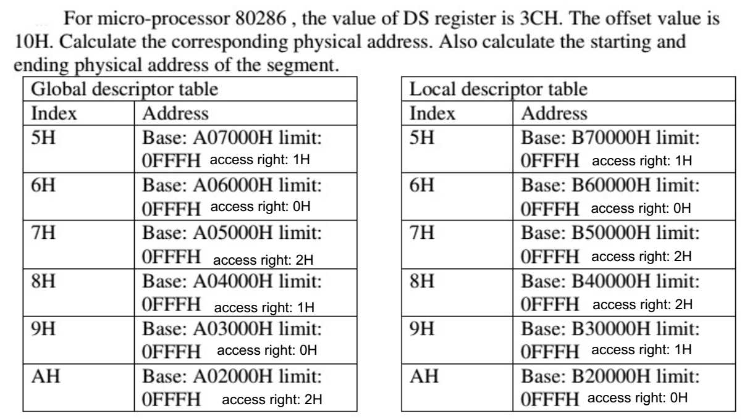
Problem

Slide 40
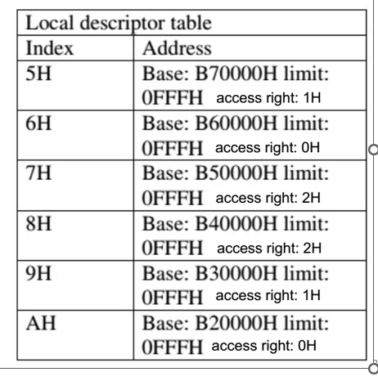
Solution
DS = 3CH = 003CH = 0000 0000 0011 1100 B
Privilege level = 00
Local Descriptor table 1
Entry number = 0000 0000 0011 1 = 7H
Physical address = Base address + offset
= B50000H + 10H
= B50010H
Starting address = Base address = B50000H
Ending address = Starting address + limit
= B50000H + 0FFFH = B50FFFH

Slide 41
Access Rights Byte
The access rights byte controls access to the protected mode segment.
  describes segment function in the system and allows complete control over the segment
  if the segment is a data segment, the direction of growth is specified
If the segment grows beyond its limit, the operating system is interrupted, indicating
a general protection fault.
You can specify whether a data segment
can be written or is write-protected.

Slide 42
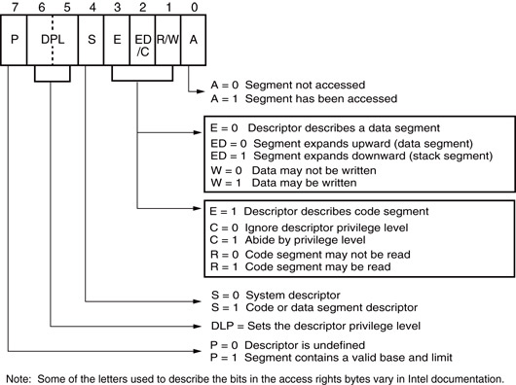
Figure 2–7 The access rights byte for the 80286 through Core2 descriptor.

Slide 43
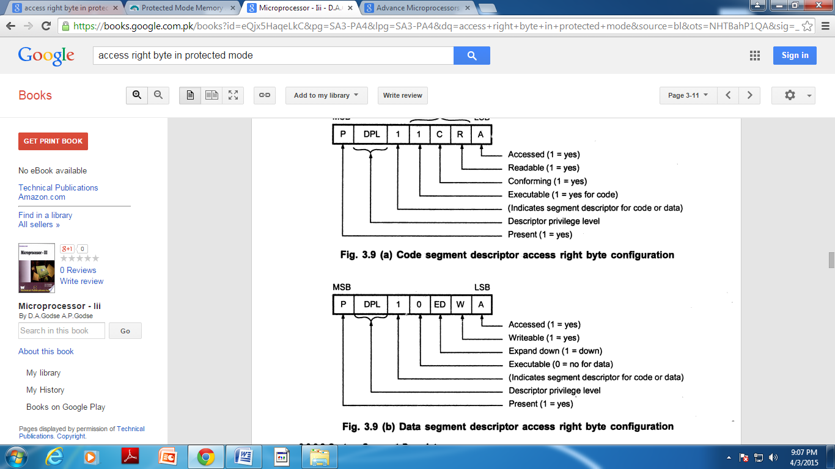
Access right byte configuration

Slide 44
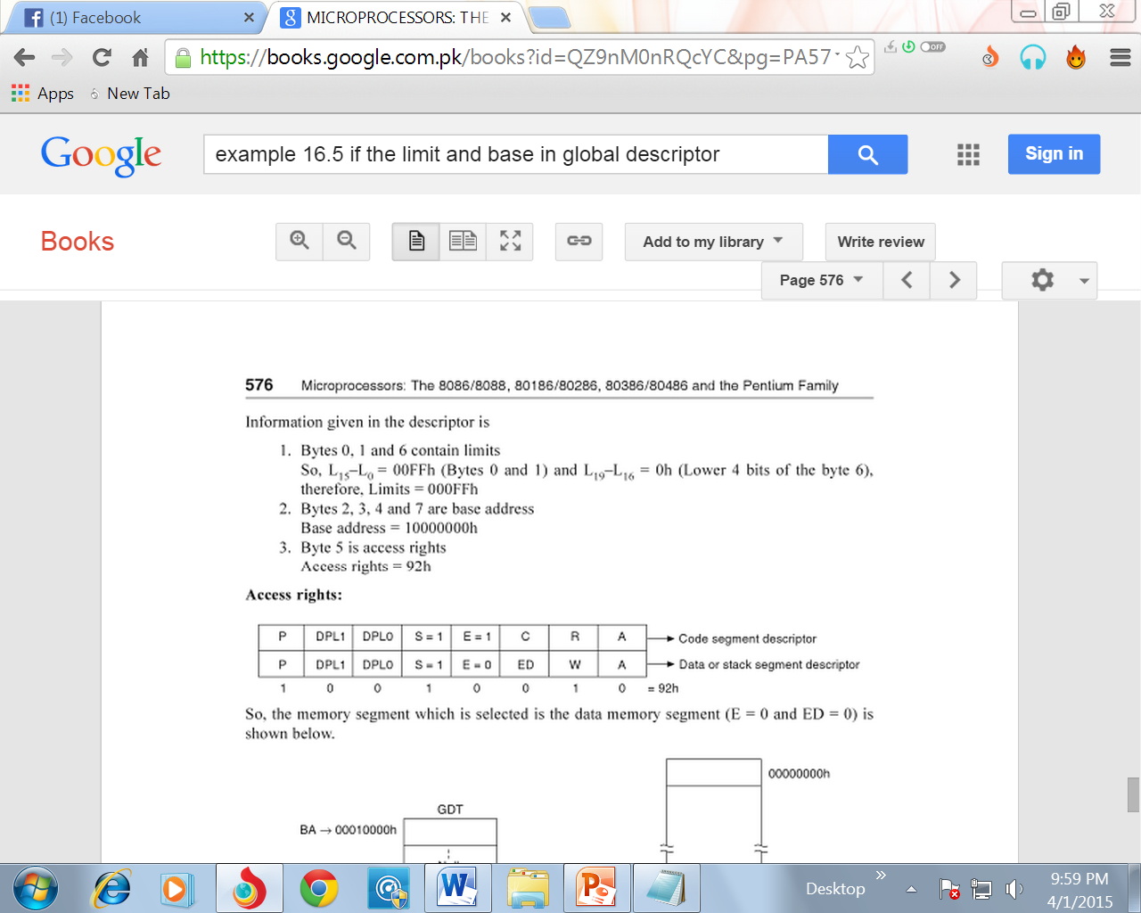

Slide 45
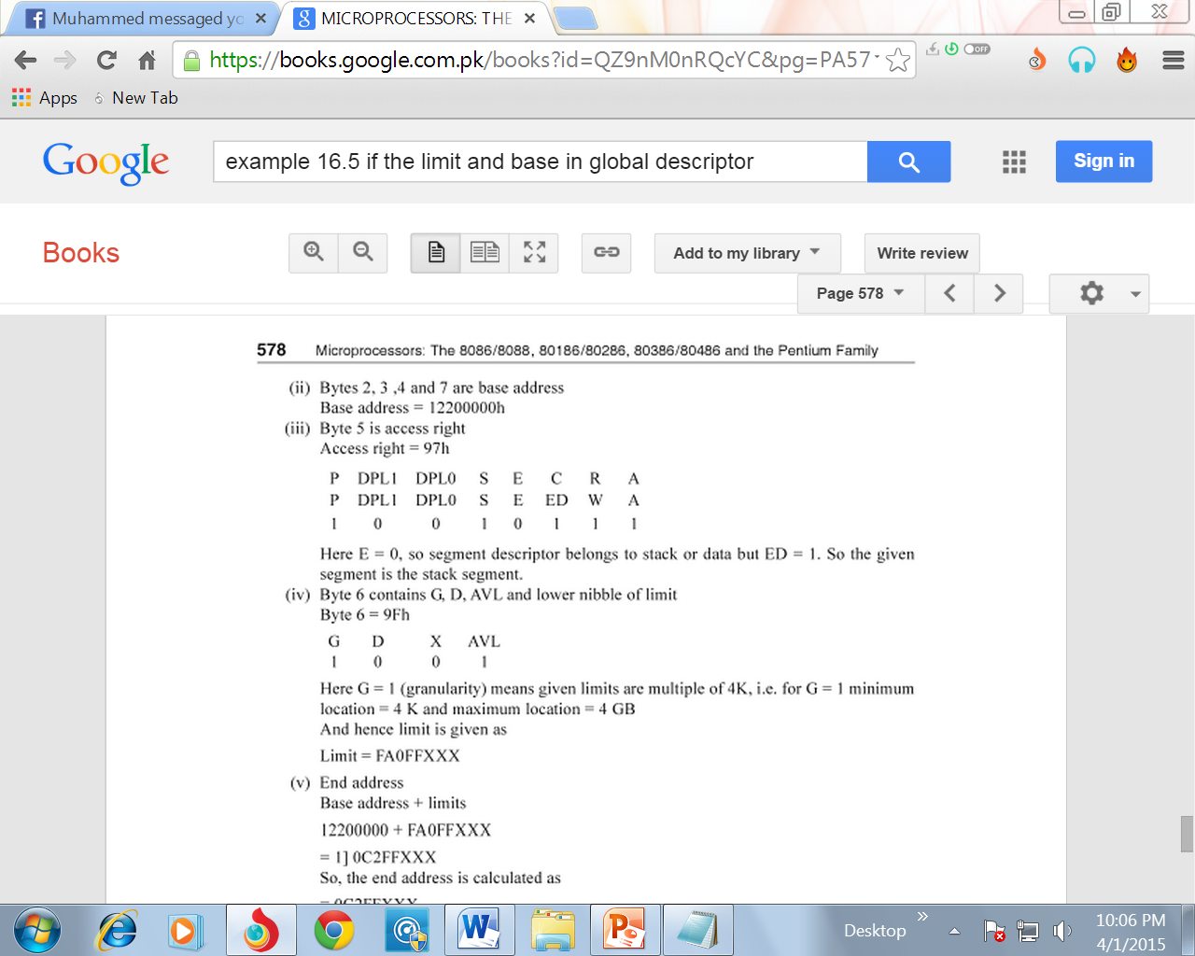
Access Rights Byte

Slide 46
  Example: Access Rights byte FEH = 1111 1110
    P = 1 Segment is mapped into physical memory
    DPL=11 Privilege level 3
    E = 1 executable code segment
    C = 1 confirming code segment
    R = 1 readable code segment
    A = 0 segment has not been accessed

Slide 47
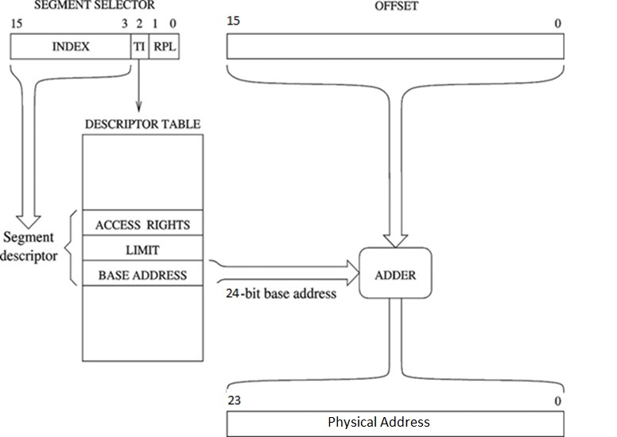
Logical to Physical Address Translation
Offset 16 bit (80286)
Upper 13 bits of segment selector are used to index the descriptor table
TI = Table Indicator
Select the descriptor table
0 = Global Descriptor Table
1 = Local Descriptor Table
GDT, LDT

Slide 48
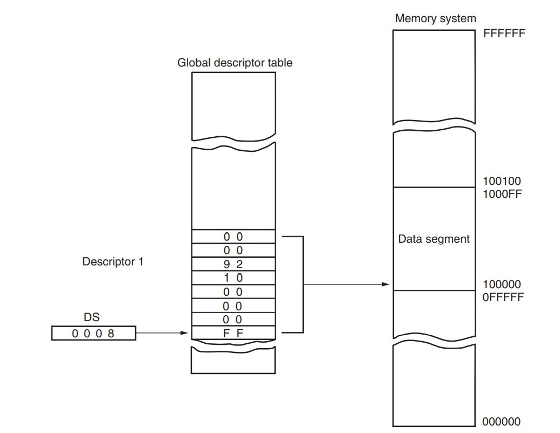

Slide 49
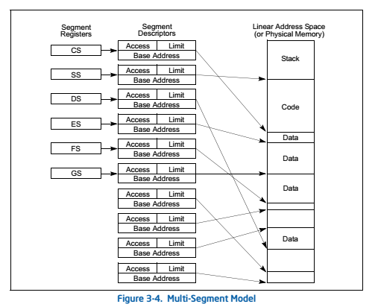

Slide 50
Privilege Levels (80286)
The privilege levels provide protection within a task. The operating system, interrupt handlers and other system software can be protected from unauthorized accesses in virtual address space of each task using the privilege mechanism. The privilege mechanism offers or denies access to a segment by using the privilege bits of the corresponding descriptor.
The 80286 supports a four level hierarchical privilege mechanism to control the access to descriptors and hence to the corresponding segments of the task. The control of the access to descriptors results in the prevention of the unwanted or undue access to any of the code or data segments or unintentional interference in the higher privilege level tasks.
Level 0 is the most privilege level (00) while level 4 is the least (11).

Slide 51
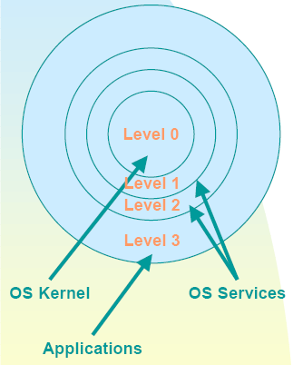
Privilege Levels (80286)
00 - kernel level (highest privilege level)
01 - OS services
10 - OS service (extensions)
11 - Applications (lowest privilege level)
Highest
Lowest

Slide 52
Privilege Levels (80286) summery
Each task assigned a privilege level, which indicates the priority or privilege of that task.
A task executing at level 0, the most privileged level, can access all the data segment defined in GDT and LDT of the task.
A task executing at level 3, the least privileged level, will have the most limited access to data and other descriptors.
In most environments, the operating system and some device drivers run in level 0 and applications run in level 3.

Slide 53
80286 Microprocessor virtual memory size calculation
The LDT has = 2^13 = 8192 number of rows
The GDT has = 2^13 = 8192 number of rows
Total number of rows = 8192 + 8192 = 16384
Each row of the descriptor table represents a memory segment of = 2^16 = 64 KB size (maximum) [limit length is 16 bit ]
Therefore, virtual memory size = 16384 * 64KB = 1 GB

Slide 54
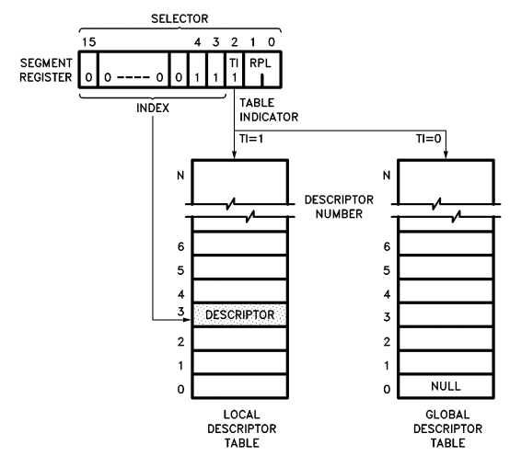
Base Address in LDTR Register
Base Address in GDTR Register

Slide 55
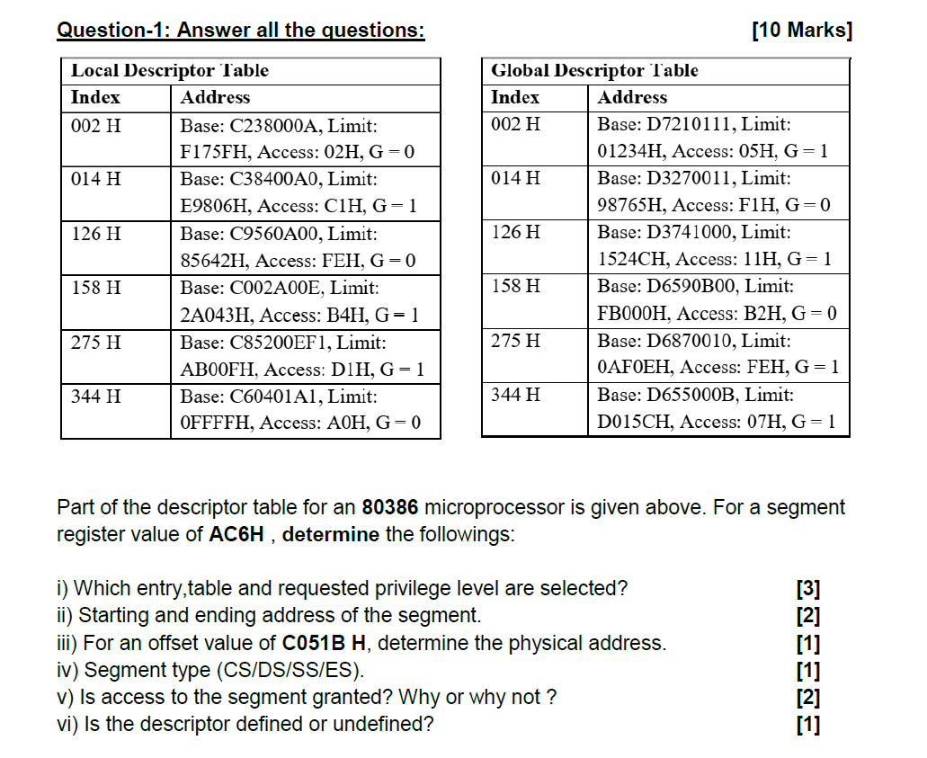

Slide 56
Solution
i) AC6H = 0AC6H = 0000 1010 1100 0110B
Privilege level = 10
Local Descriptor table because 3rd bit is 1
Table entry = 0000 1010 1100 0 = 158H
ii)Starting address = Base address = C002A00EH
As G = 1, Ending address = Base address + limit*4K
= C002A00E + 2A043FFF = EA06E00DH
iii) Physical address = Base address + offset
= C002A00E + C051B = C00EA529H

Slide 57
Solution
iv) Access: B4H = 1011 0100
As E = 0, it is either data or stack segment.
ED = 1, so segment expands downward. That is why, it is stack segment.
v) As A = 0, so access not granted.
vi) As P = 1, so the segment is defined.

Slide 58
Thank You

